Slide 1

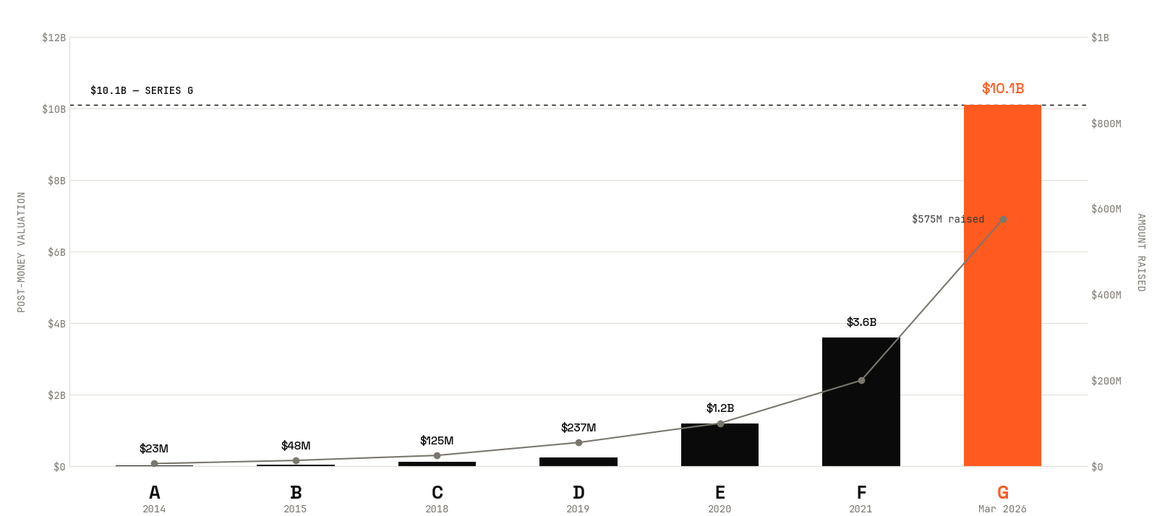
VALUATION.
01 / 12
Is WHOOP worth $10.1 billion?
BUSN 20410 · SPRING 2026 · YANNELIS

Slide 2
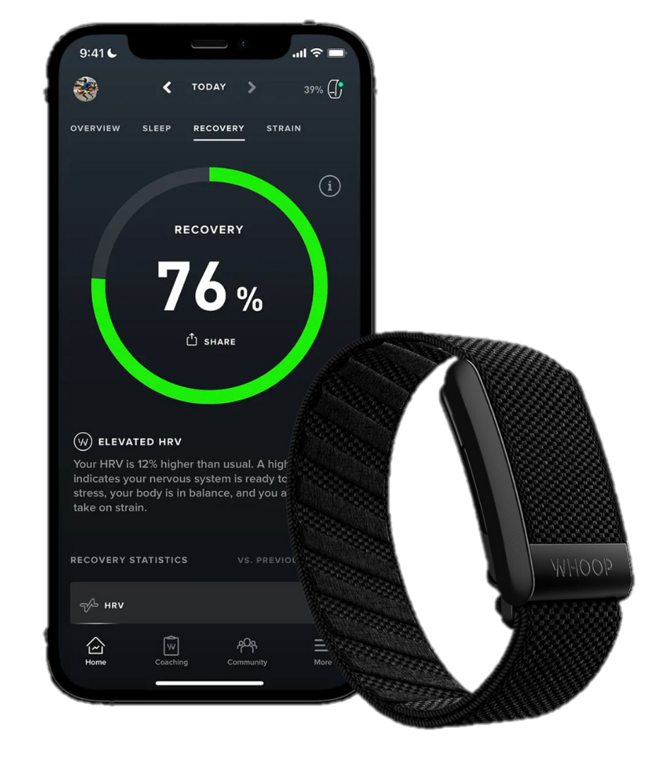
VALUATION.
COMPANY
02 / 12
01
WHAT THEY DO
24/7 health & fitness wearable. Tracks recovery, strain, sleep, and biometric trends across continuous monitoring.
Targeted for professional athletes and serious fitness enthusiasts, particularly in endurance sports and professional leagues
Focusing on healthcare reimbursement + women’s health monitoring
A premium wearable with healthcare ambitions.
Round mechanics
$575M
Series G raise
$10.1B
Post-money
$3.6B
Series F (2021)
2.8×
F → G step-up
02
HOW THEY MAKE MONEY
Hardware bundled free with subscription.
~80% recurring consumer subscription ($199 / $239 / $359 tiers).
~20% B2B Unite (employer / team contracts).
78% gross margin — closer to software than hardware.
03
WHY HARD TO VALUE
No direct public comp. Closest analog (Oura) is private.
Hardware comps undervalue the recurring base.
Subscription comps don't capture healthcare optionality.
Health-data comps just compressed 50–67% on the public side.

Slide 3
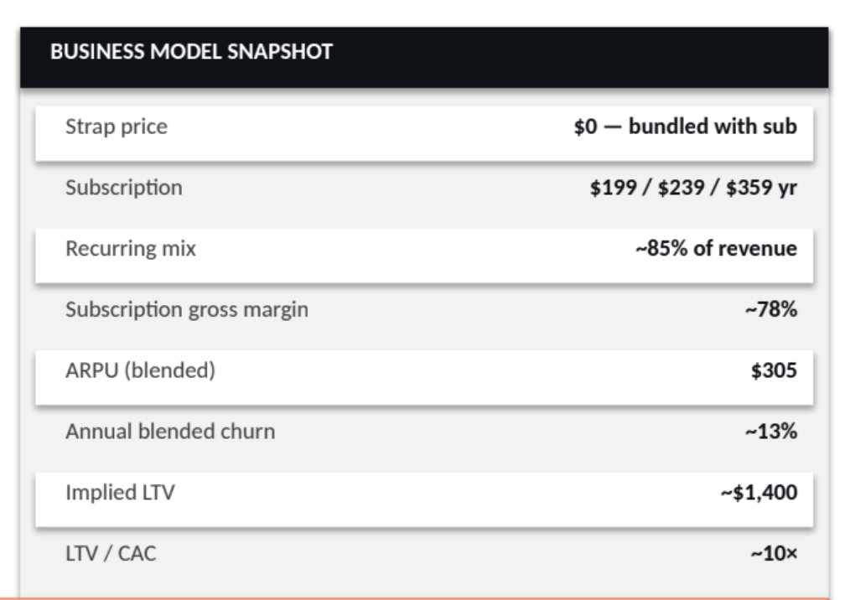
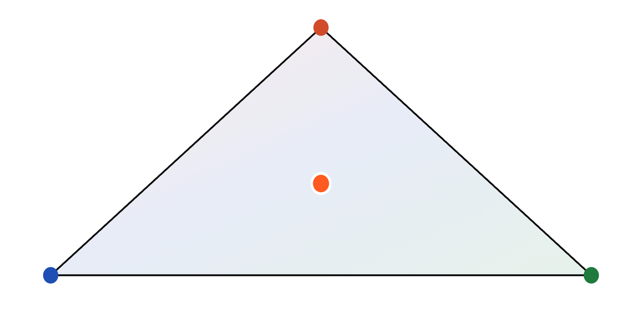
VALUATION.
02 / 12
IDENTITY
Business Model + Industry Outlook (TAM Expansion).
WHOOP is simultaneously a hardware OEM, a subscription business, and a health-data platform. The comp set you choose pre-determines your answer.
Consumer Hardware
GARMIN · FITBIT · GOPRO
WHOOP — AT THE INTERSECTION
Consumer Subscription
Health Data Platform
PELOTON · SONOS · ROKU
DEXCOM · MASIMO · IRHYTHM
IDENTITY DRIVES THE MULTIPLE. WE TEST ALL THREE.

Slide 4
VALUATION.
03 / 12
METHOD
Separating consumer subscription economics with healthcare optionality.
Approach | What it does | Why we rejected / adopted
Naive | Single DCF, blended ARPU including healthcare upside, no scenarios | Conflates two uncertainty types; assumes 100% probability on optionality; no analytical separation
Common practitioner | Bear/Base/Bull DCF, no real options; healthcare baked into Bull case | Healthcare optionality dilutes Bull thesis; probability of healthcare success isn't separable from member growth
Ours | Disciplined two-driver DCF + separate real option layer + probability weighting | Each uncertainty type modeled with appropriate framework: continuous (DCF) vs discrete-binary (DTA)
Intrinsic Layer

Slide 5
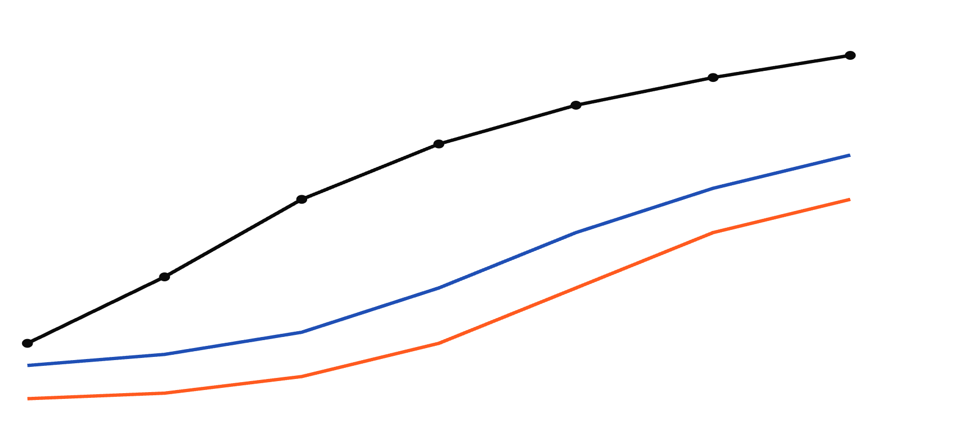
VALUATION.
04 / 12
DCF · BUILD
Revenue = Members X ARPU
WHOOP isn't one business across the forecast — it's a hypergrowth story that has to land.
$3B
PHASE 1
PHASE 2
PHASE 3
KEY ASSUMPTIONS
Y1–Y3 · PRE-IPO HYPERGROWTH
Y4–Y5 · MARGIN INFLECTION
Y6–Y7 · TERMINAL ECONOMICS
TOP-LINE
$2B
Subscriber growth Y1 → Y7
2.5M → 11.4M
Subscriber CAGR
+24%
$1B
ARPU trajectory
$324 → $396
RETENTION
$0
Entering churn
21%
Terminal churn
14%
REVENUE
EBITDA
FCF
MARGIN & DISCOUNT
−$0.5B
Terminal EBITDA margin
26%
Y1
Y2
Y3
Y4
Y5
Y6
Y7
Terminal growth (g)
3.0%
WACC (base)
10.5%
Comp-set beta
1.32 (relevered)
WACC BUILT VIA CAPM (LECTURE 1B). COMP BETAS RELEVERED VIA HAMADA (LECTURE 2B).
Notes:
"we use 4.5x exit multiple primary; implied perpetuity growth is ~5% reflecting platform durability vs Gordon at 3%; both methods triangulated within 30%." Shows you understand the embedding.

Slide 6
DCF logic:
We have base/bear/bull cases across major assumptions – that gets use ragne from 3B – 19B
however these strong bear and bull exist because inputs/assumptions correlate and compound on each other; they are convex
So we dervive secarios of bull/bear/base cases and attatch them with probabilities themselves to get an EV of outcomes -- we use the outcomes of comparables companies loosely to
treat base case as 50% likely bear 20% / bull 30% to get a scenario based DCF landing at around 10B ; we then do input driven DCF and land at 8B. This gap is the Jensen principle.
This exists because of it … . The insight is without any healthcare reimbursement upside baked into DCF (expanding ARPU and members); we treat bull case as enough members com
We then present the football field showing our different valuation inputs; we have the base case DCF with no healthcare upside * the scenario that captures the upside
Our comps are shown to give us an anchor or floor for the company. What the comps are showing is that no other company besides maybe OURA is going after the consumer/biometric/healthcare
Thesis. Series G explicility prices this in. Our position is more bullish/bearish or what?

Slide 7
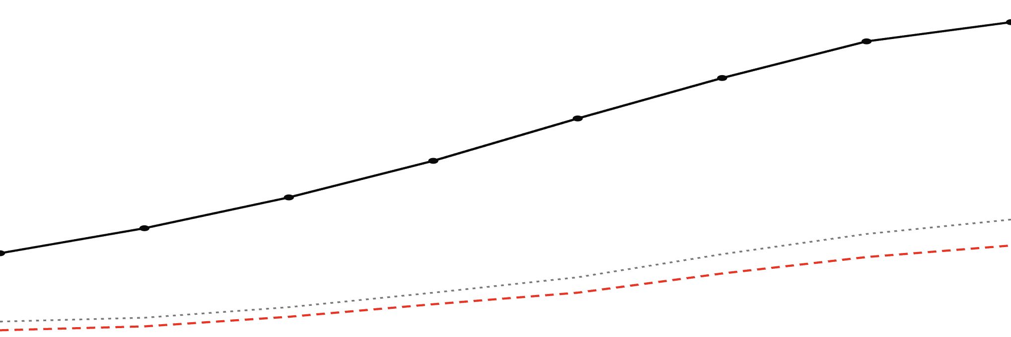
WHOOP / VALUATION
05 / 12
·
DCF · BUILD
Three phases. Seven years.
WHOOP isn't one business across the forecast — three phases, each a distinct operating thesis stitched together via unit economics.
REVENUE
TOP-LINE DRIVERS
$3.5B
PHASE 1 · PRE-IPO HYPERGROWTH
PHASE 2 · MARGIN INFLECTION
PHASE 3 · TERMINAL ECONOMICS
EBITDA
Members Y1 → Y7
2.5M → 10.24 M
2028 – 2030 · EBITDA 18% → 28%
2031 – 2033 · RULE OF 40 ≈ 50
FREE CASH FLOW
Member CAGR
20.2%
2026 – 2027 · MEMBER GROWTH +50%
Blended ARPU
$305 → $348
Members bottom-up via S&M÷CAC. ARPU = 0.80×$319 + 0.20×$260.
$2.6B
MARGIN PROFILE
Gross margin (terminal)
78%
Terminal EBITDA
37%
$1.75B
Anchored to Spotify post-profitability (28%) + WHOOP GM premium.
★ WACC BUILD · BOTTOM-UP
$0.9B
Risk-free (10Y UST)
4.30%
+ β_{U} 0.97 × ERP 4.61%
+4.49%
Cost of equity (CAPM)
8.79%
+ Private co. premium
+2.00%
Anchored to Oura tender · Jan 2026
$0
WACC
10.79%
2026
2027
2028
2029
2030
2031
2032
2033
Bottom-up β from comp regressions (Hamada-relevered) — not Damodaran medians. Sens. 9.8–11.8%.
EXIT & TERMINAL VALUE
UNIT ECONOMICS CHAIN · Y1 → Y7
Exit multiple (EV/Rev)
3.5×
MEMBERS
×
BLENDED ARPU
=
REVENUE
→
EBITDA MARGIN
Perpetual growth (g)
3.0%
2.5M → 8.4M
$305 → $417
$0.87B → $3.27B
18% → 37%
Gordon / Exit-mult TV
$11.9B / $11.4B
18% CAGR
3.4% CAGR
21% CAGR
S&M 30%→18%
Spotify 4.1× / Roku 3.4×. Healthcare optionality in RO layer — not double-counted.
WACC: BOTTOM-UP CAPM (LECT 1B) + HAMADA RELEVER (LECT 2B) + OURA PRIVATE PREMIUM · EXIT: SUBSCRIPTION-ANCHORED (LECT 7) · HEALTHCARE OPTIONALITY SEPARATE IN RO LAYER (LECT 3B)
05 / 12

Slide 8
VALUATION.
05 / 12
DCF · OUTPUT
SLIDE 05 · DCF OUTPUT & SENSITIVITIES
Base case $8.4B — but identity matters more than precision.
The biggest single driver is which comp set anchors WACC — i.e., the public market's identity question, priced inside the discount rate.
EV → EQUITY WATERFALL ($B)
TORNADO — EQUITY VALUE SENSITIVITY
$ B IMPACT
PV of Explicit FCF (Y1–Y7)
+ 4.1
−$3B
−$1.5B
$0
+$1.5B
+$3B
WACC by comp bucket
±2.8
PV of Terminal Value
+ 5.2
Hardware → Subscription → Health Data
Terminal EBITDA margin
±2.0
Enterprise Value
9.3
22% / 26% / 30%
− Net Debt
− 0.6
Subscriber growth Y3
±1.6
+18% / +24% / +30%
+ Cash & Equivalents
+ 0.4
Terminal churn
±1.1
− SBC overhang
− 0.7
Terminal growth (g)
±0.7
2% / 3% / 4%
Equity Value (base)
$8.4B
Bear
Base $8.4B
Bull
SENSITIVITY RANGE
$5.8B — $12.1B
CASH-FLOW ESTIMATION ERROR DOMINATES DISCOUNT-RATE PRECISION (LECTURE 1B FRAMING)

Slide 9
VALUATION.
06 / 12
REAL OPTIONS · ARUNDEL
SLIDE 06 · REAL OPTIONS
DCF prices the business. It doesn't price the optionality.
WHOOP holds three real options that are zero in the base DCF but materially valuable on a Black–Scholes frame — Arundel-style sequel rights on uncertain future cash flows.
01
Health-data monetization
+$1.6B
STYLIZED BLACK–SCHOLES INPUTS
Insurer / employer data licensing & reimbursement pathway
S
Underlying — PV of expansion-business cash flows if exercised
$3.4B
Medical-device pivot
K
Strike — investment required to enter (R&D + go-to-market)
$1.8B
02
FDA clearance pathway · BP, AFib, sleep-apnea modules
+$0.9B
σ
Volatility — comparable health-tech equity vol
52%
Enterprise / B2B platform
T
Time to decision window
5.0 yrs
03
Corporate wellness contracts · pro-team deployments
+$0.5B
r
Risk-free rate (5Y Treasury)
4.2%
DCF BASE + OPTION PREMIUM = TOTAL INTRINSIC ($B)
C
Aggregate option premium
+$3.0B
DCF base
8.4
+ Option 01
10.0
+ Option 02
10.9
+ Option 03
11.4
LECTURE 3B / ARUNDEL — LIKE ARUNDEL'S SEQUEL RIGHTS, WHOOP'S EXPANSION OPTIONS ARE CALL OPTIONS ON UNCERTAIN FUTURE CASH FLOWS.

Slide 10
VALUATION.
07 / 12
COMPS
SLIDE 07 · TRADING COMPS
The comp range is the analysis.
Each bucket implies a different valuation; the spread quantifies the identity question — and not all comps survive the public-market test equally.
12×
IMPLIED EQUITY VALUE AT BUCKET MEDIAN
Hardware bucket
$2.2B
WHOOP — HEALTH
2× rev · ~$1.1B rev
Dexcom · 9.4×
iRhythm · 10.2×
Subscription bucket
9×
Inspire · 8.6×
$3.9B
Masimo · 7.8×
3.5× rev
WHOOP — SUB
Health-data bucket
$9.4B
6×
Roku · 4.1×
8.5× rev
EV / REVENUE (NTM)
Sonos · 3.2×
Fitbit · 1.6×
Peloton · 2.6×
POST-IPO FATES OF NAMED COMPS
WHOOP — HW
PELOTON (SUB)
GARMIN (HW)
DEXCOM (HD)
3×
Garmin · 2.4×
−70%
+85%
+400%
GoPro · 0.9×
From IPO peak
5-year total return
10-year from IPO
Comps imply different multiples — and different fates.
0×
0%
15%
30%
45%
60%
REVENUE GROWTH — NTM YOY
TRADING MULTIPLES ARE RELATIVE-VALUE, NOT INTRINSIC. THE DISPERSION IS THE ANSWER.

Slide 11
VALUATION.
08 / 12
★ NOVELTY · BACK-SOLVE
SLIDE 08 · SERIES G BACK-SOLVE
What does $10.1B actually mean?
Headline post-money ≠ common-equivalent value. Adjusted for preferences, the Series G implies operating assumptions that may or may not be defensible.
$10.1B
− $0.9B
− $0.6B
− $0.4B
$8.2B
Headline post-money
1× non-participating liquidation preference
Ratchet / anti-dilution value
Participation / seniority rights
Common-equivalent implied valuation
WHAT THE PRICE REQUIRES VS. WHAT WE MODEL
ONE-SENTENCE VERDICT
IMPLIED @ $8.2B CE
OUR BASE CASE
The market is paying for a health-data trajectory ; our DCF supports a premium consumer subscription . Real options close ~70% of the gap — but not all of it.
Subscriber count by Y5
8.4M
7.1M
Terminal EBITDA margin
29%
26%
Revenue CAGR (Y1–Y7)
26%
22%
COMMON-EQUIV. GAP
~$1.9B
Terminal churn
12%
14%
WACC
9.5%
10.5%
GORNALL & STREBULAEV (2020) · CAPITAL STRUCTURE (LECTURES 4C, 6A) — LIQUIDATION PREFS ARE DEBT-LIKE CLAIMS SENIOR TO COMMON.

Slide 12
VALUATION.
09 / 12
VERDICT
SLIDE 09 · TRIANGULATION
The verdict — modestly over.
Five methods, one chart. The Series G headline sits at the upper edge of the central cluster; only the health-data bucket and DCF + options reach for it.
$10.1B SERIES G
METHOD 01
5.8
12.1
DCF — base & sensitivity
METHOD 02
7.4
14.9
DCF + Real Options
METHOD 03A
1.2
2.8
Comps — Hardware
METHOD 03B
3.0
4.6
Comps — Subscription
METHOD 03C
7.4
13.0
Comps — Health Data
METHOD 04
$8.0
$9.0
Series G common-equiv.
$0
$4B
$8B
$12B
$16B
Central estimate $9.6B · weighted across DCF + options + comps. Series G headline overstates common-equivalent value by ~6% ; the market is paying an option premium on the health-data trajectory.
VERDICT OVER ~6%
SYNTHESIS — NO SINGLE METHOD IS DISPOSITIVE; WEIGHTED VIEW ACROSS METHODS (LECTURE 1A)

Slide 13
VALUATION.
10 / 12
HONEST SENSITIVITY
SLIDE 10 · WHAT WOULD CHANGE OUR MIND
Three triggers that flip the verdict.
Assumptions are theses, not knobs. Here are the three that matter most — and what each does to the answer.
01
Churn runs +200 bps above modeled — terminal lands at 16%, not 14%.
→
DCF base drops ~14% . Hardware bucket becomes the correct comp; verdict flips to over ~25%.
02
Health-data option does not materialize by Y5 — no FDA reimbursement pathway, no insurer contracts.
→
Option premium collapses; DCF + options range converges to DCF. Central estimate falls to ~$8.4B.
03
IPO re-rates to a Peloton trajectory — public market validates the Hardware bucket post-bell.
→
Multiple compresses 60–70% from Series G; Series G overstates common-equivalent by ~50%.
ASSUMPTIONS ARE THESES, NOT KNOBS. PRE-EMPTS HOSTILE Q&A.

Slide 14
VALUATION.
11 / 12
ONE SENTENCE
SLIDE 11 · CLOSING
WHOOP at $10.1B is priced as a health-data platform. We value it as a consumer subscription with optionality and find the headline overstates common-equivalent value by ~6%.
QUESTIONS ?

